Slide 1

Departure Delay Prediction of Flights
Predictive Analytics Project in R
John Kalathil
MS-Business Analytics
Purdue University
Mar 25, 2019

Slide 2
Analytics Problem
Flight Delay costs millions of $$ to US economy every year
Huge discomfort caused
Defined a classification problem: flight above 15min delayed
Tools:
R Programming, Libraries: ggplot, caret, MS - Excel

Slide 3
Data, Methodology and Model
Data Source:
US Flights Data, US Census Report, Airports Database
Methodology:
EDA – variation in flight delay across carriers, months, day of week, etc.
Feature Engineering: Holidays, Airport Quality, Flights Rating
Models:
Logistic Regression, Naïve Bayes, Decision Tree, Neural Network

Slide 4
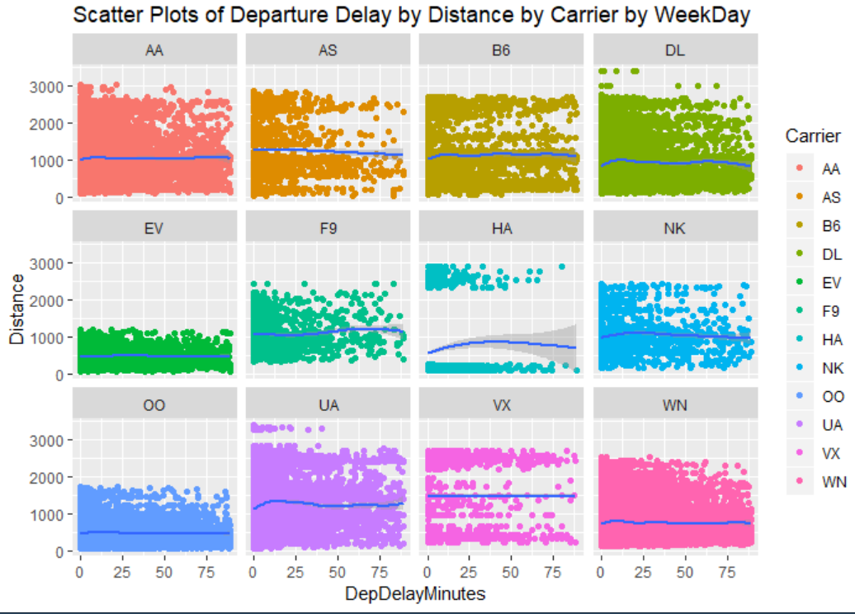
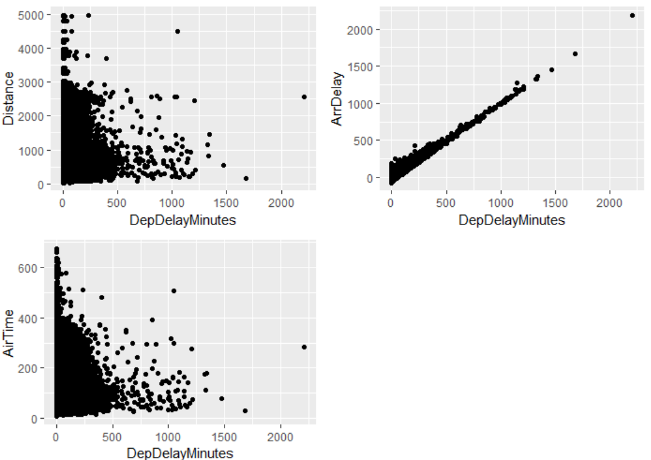
EDA Charts

Slide 5
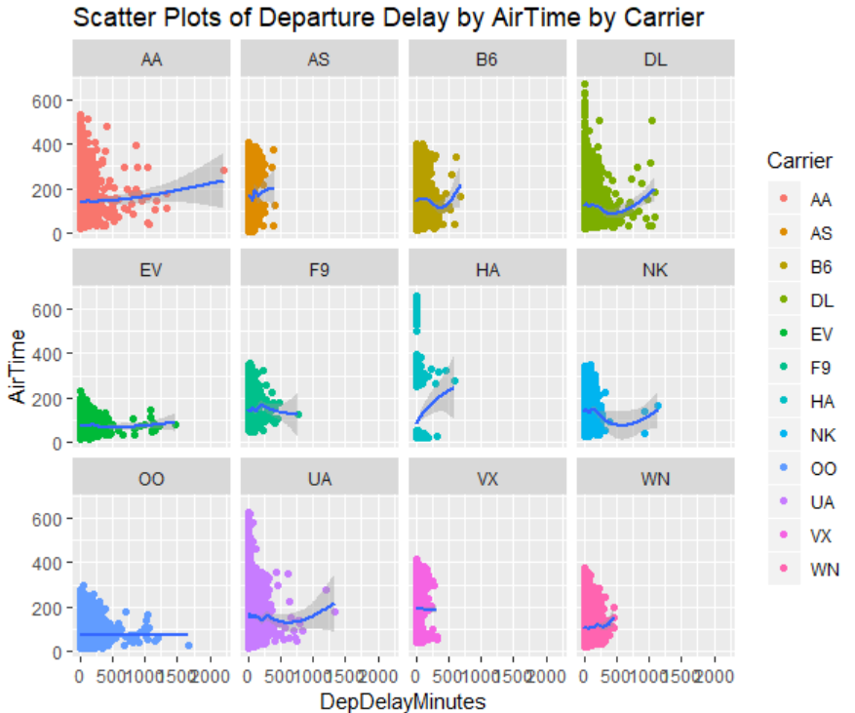
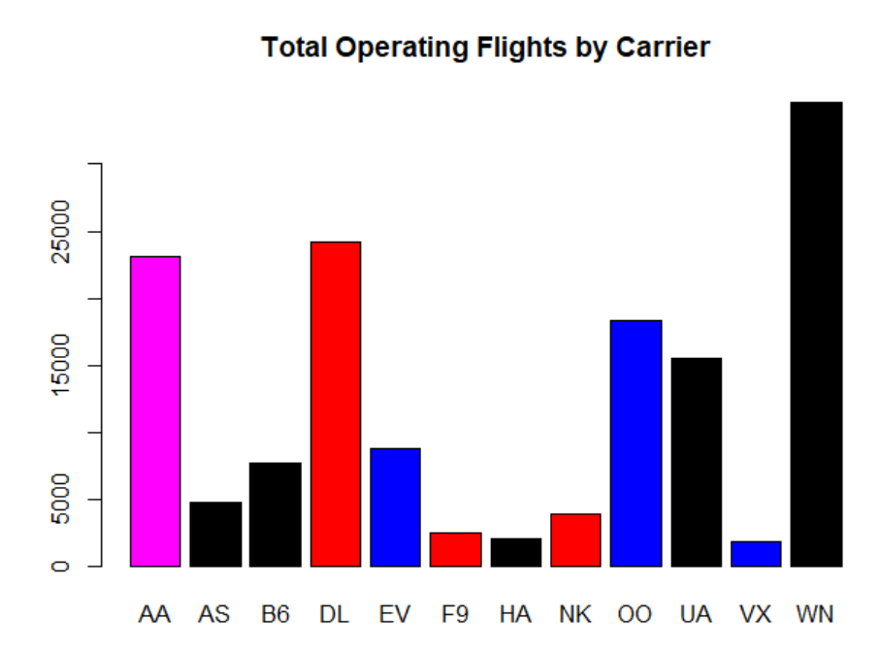
EDA Charts

Slide 6
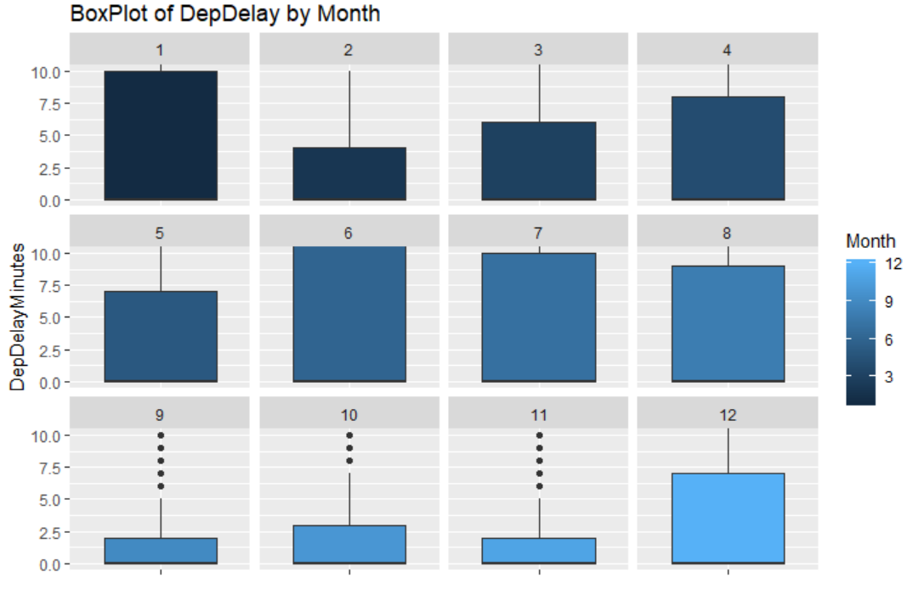
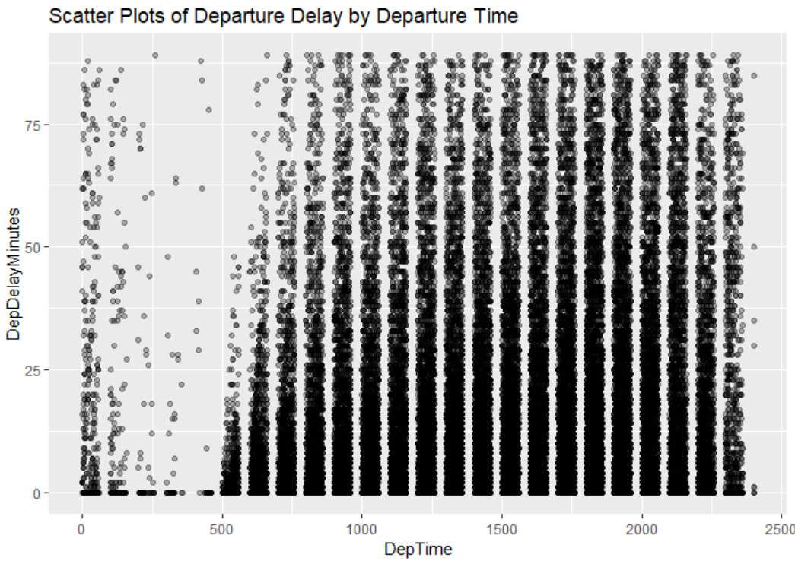
EDA Charts

Slide 7
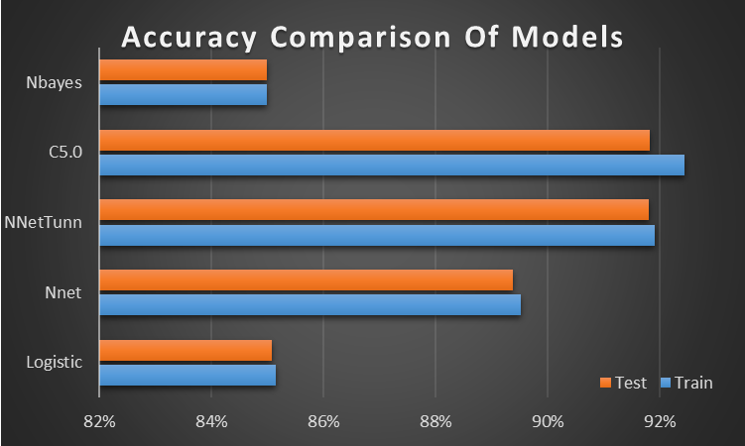
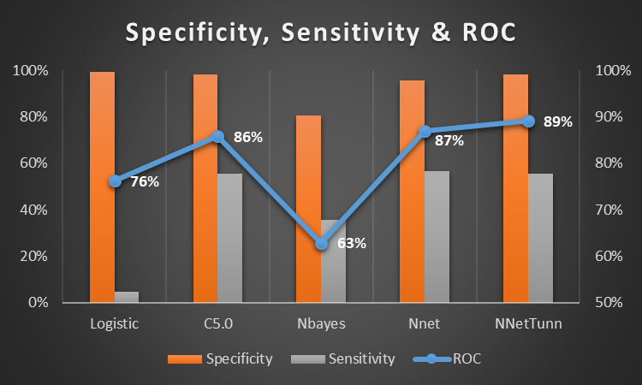
Results

